Slide 1
Unraveling Uzbek: A Journey into a Morphologically Rich, Low-Resource Language
More than just words, it's about structure.

Slide 2
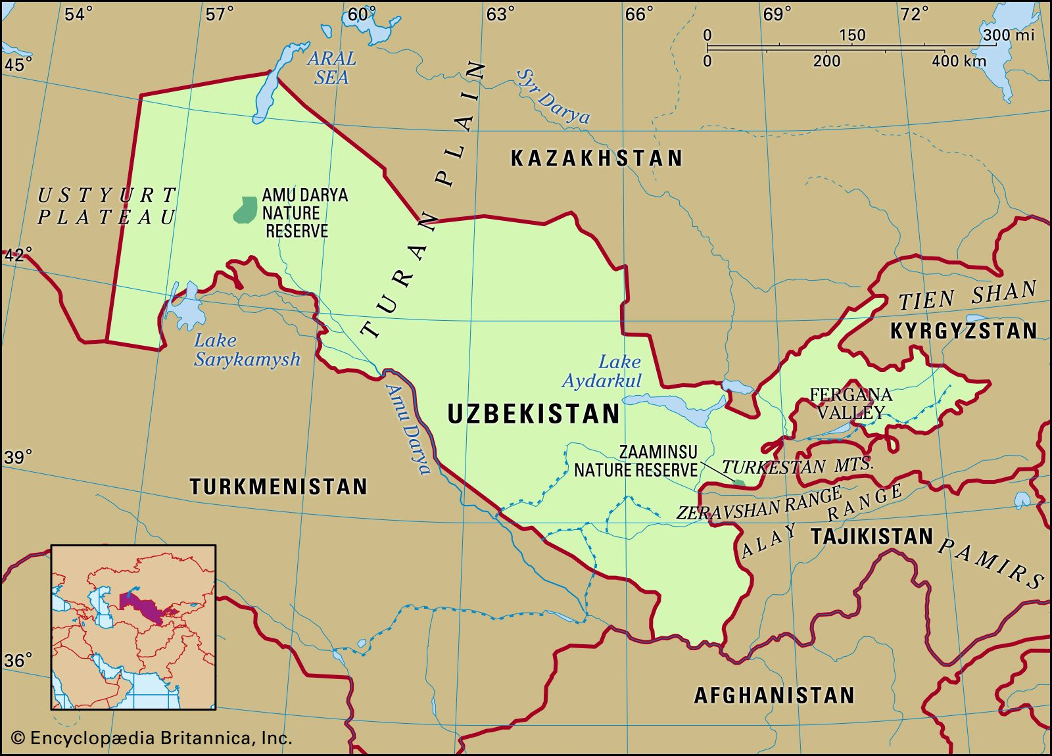
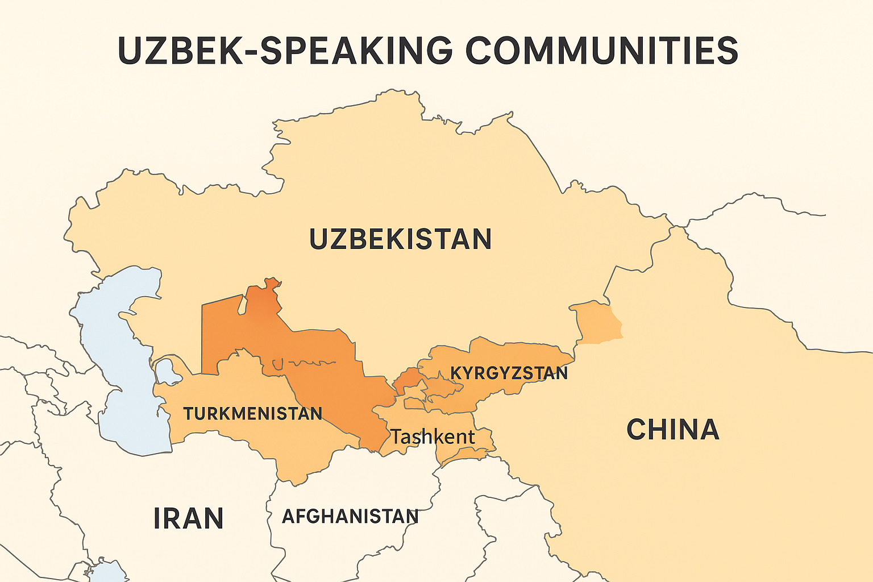
Uzbek: A Turkic language
Official language of Uzbekistan.
Spoken by over 34 million people globally.
Belongs to the Turkic language family, making it a relative of Turkish, Kazakh, and Azerbaijani.
Characterized by its agglutinative nature.

Slide 3
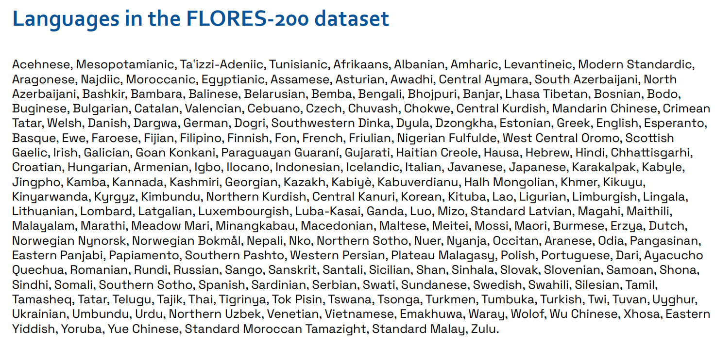
Low-resource or extremely low-resource languages represent more than 95% of the languages of the world
Uzbek is here!

Slide 4
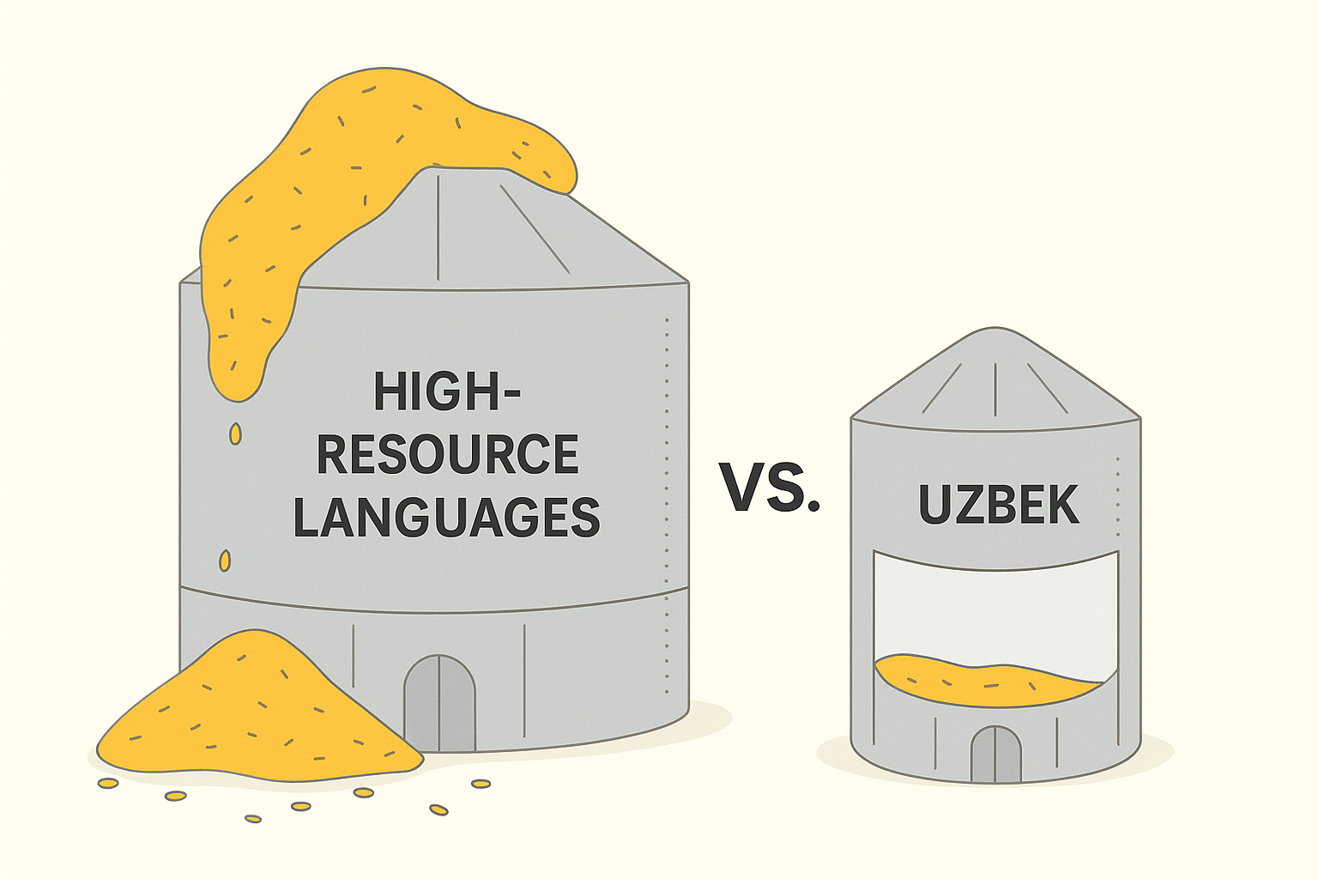
Why is Uzbek "Low-Resource"? The Digital Divide: What 'Low-Resource' Means
Limited Digital Data: Scarcity of readily available text and speech data for computational linguistics.
Fewer Parallel Texts: Not enough translated documents crucial for training machine translation systems.
Underrepresented in NLP Tools: Fewer dedicated tools, libraries, and pre-trained models for Natural Language Processing.
Challenges in Development: Requires more effort and specialized approaches to develop AI and language technologies.

Slide 5
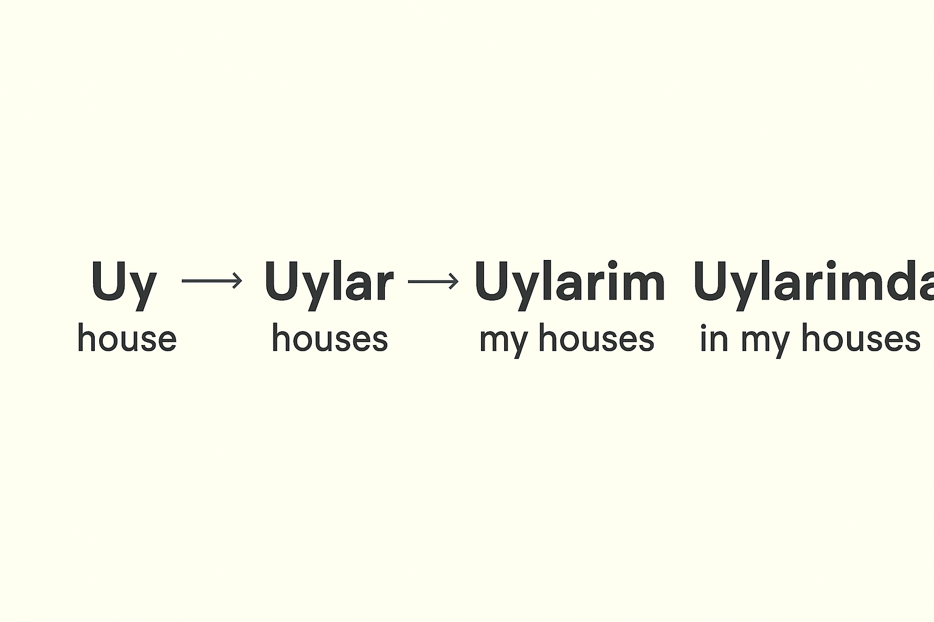
A Single Word, Many Meanings: The Power of Morphology
Agglutinative Language: Uzbek builds words by adding multiple suffixes to a root word.
Each suffix typically conveys a single grammatical meaning (e.g., tense, case, number, possession).
The root word itself usually remains unchanged, acting as a stable base.

Slide 6
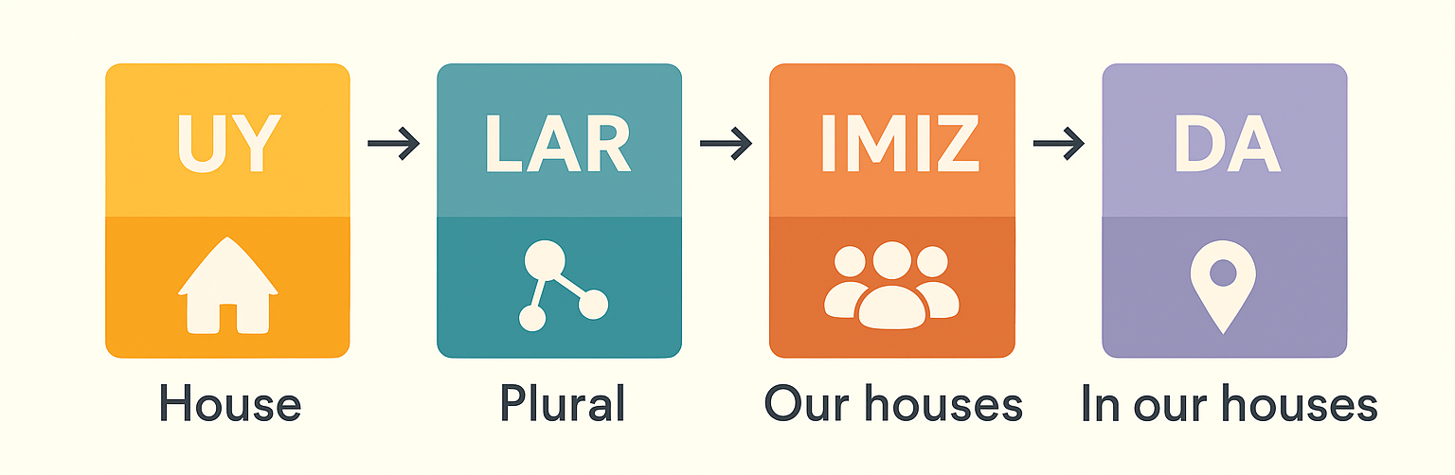
Breaking Down a Word: “Uy-lar-imiz-da”
Root: Uy (house)
Suffix 1: -lar (plural marker)
Meaning: "houses"
Suffix 2: -imiz (1st person plural possessive marker)
Meaning: "our houses"
Suffix 3: -da (locative case marker)
Meaning: "in / at"

Slide 7
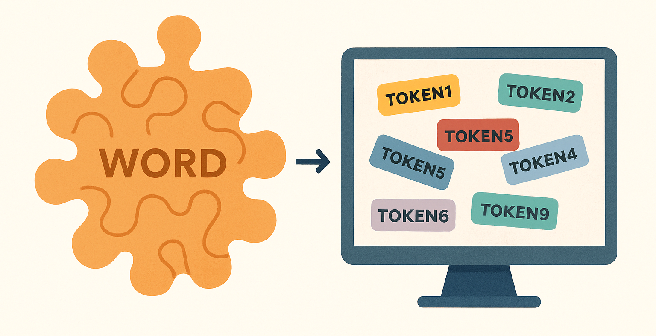
A Puzzling Task for AI: Vocabulary Explosion
Massive Vocabulary: For computers, each unique word form (e.g., uy, uylar, uylarim, uylarimda) is often treated as a separate vocabulary item.
Data Scarcity Amplified: This "vocabulary explosion" means a language model needs to learn millions of distinct forms, drastically increasing the data required for effective training.
Complexity for NLP: Developing robust algorithms for tasks like machine translation or text analysis becomes significantly more complex.
Resource Intensive: Requires more computational power and more sophisticated modeling techniques.

